Slide 1
BMD ENG 301 Quantitative Systems Physiology (Nervous System)
Final Review Questions from Students
Professor Malcolm MacIver

Slide 2
Final Exam: Friday Dec 9 9am, Split between LR3 and Pancoe (you will get notified which room next week). Extended time room: TBA.
Office hours during Finals week:
Emily Schafer Tuesday 2:30pm Tech M345 First 30-45 minutes will be review; second half will be normal office hours style. The review will be recorded for students unable to make it.Thursday 2pm-3:30pm on zoom, at channel https://northwestern.zoom.us/j/6162956576
Weihong Yeo: Thursday 10-11am Tech E311
Malcolm MacIver Wednesday 3pm-5pm. Willens Wing Atrium. If you don’t find me in Willens Wing Atrium, please knock on my office door in the Willens Wing, B292.

Slide 3
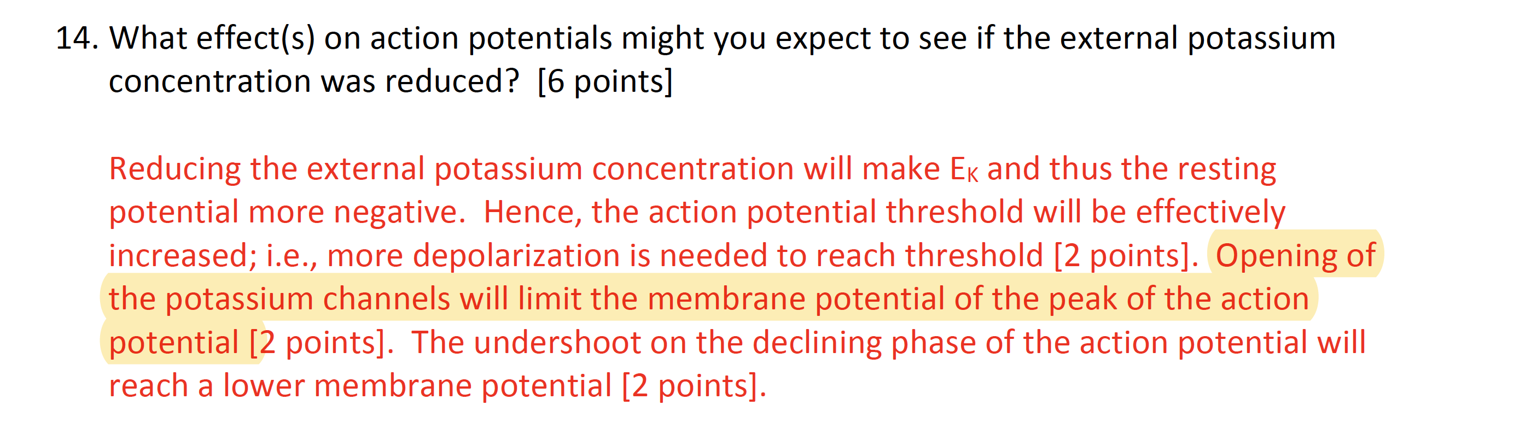

Slide 4
Q: Can we go over the structure of the muscle again (content from the muscle lecture- is the myofibril the smallest unit or is it made up of sarcomeres which are then the smallest unit
Q: Please review stretch reflex circuitry (figure 16.10)
Q: Gamma neurons and modulation of set point of intrafusal fibers
Q: Are soleus muscles extrafusal and tibius anterior muscles intrafusal?

Slide 5
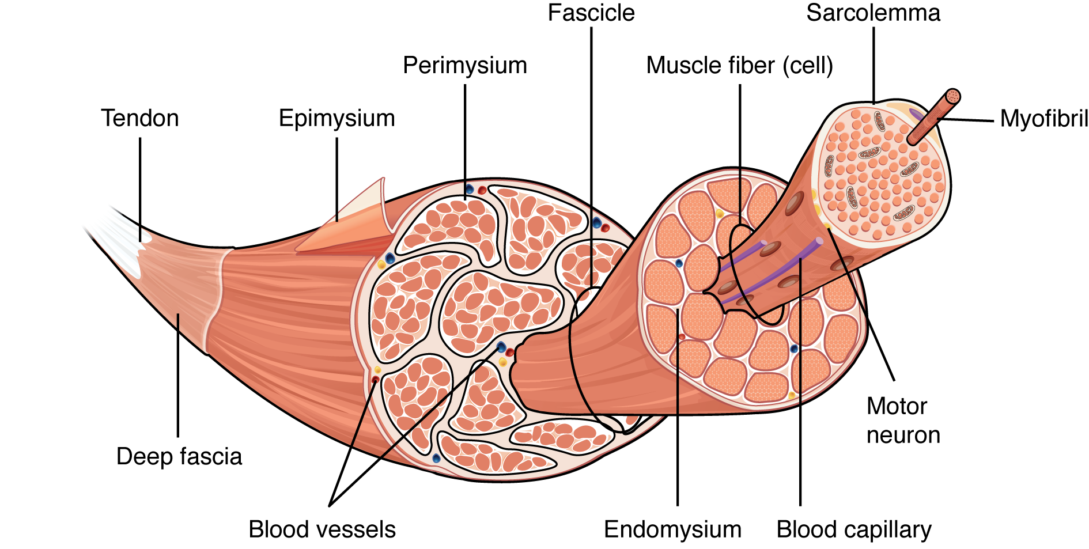
Muscle Structure and the Neuromuscular Junction

Slide 6
Q: Can we go over the structure of the muscle again (content from the muscle lecture- is the myofibril the smallest unit or is it made up of sarcomeres which are then the smallest unit
Q: Please review stretch reflex circuitry (figure 16.10)
Q: Gamma neurons and modulation of set point of intrafusal fibers
Q: Are soleus muscles extrafusal and tibius anterior muscles intrafusal?

Slide 7
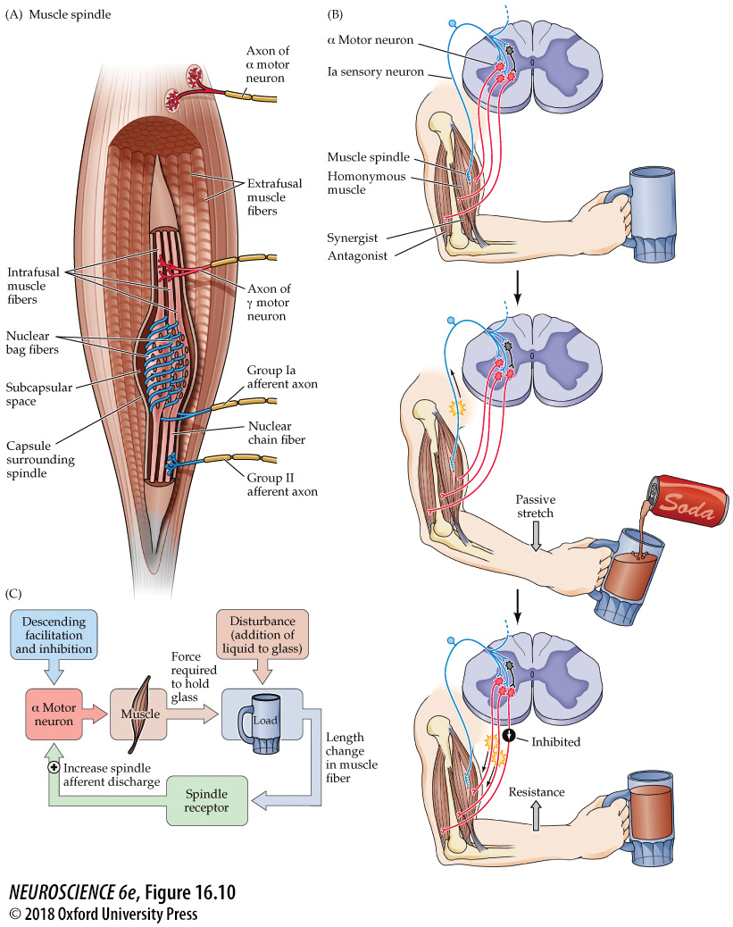
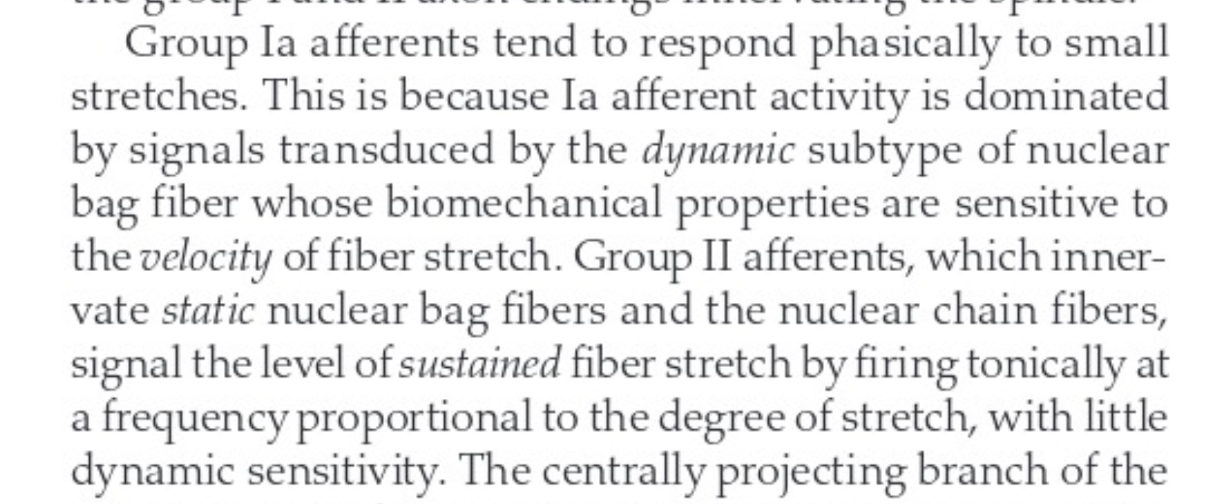
Stretch reflex circuitry
P. 368:

Slide 8
Q: Can we go over the structure of the muscle again (content from the muscle lecture- is the myofibril the smallest unit or is it made up of sarcomeres which are then the smallest unit
Q: Please review stretch reflex circuitry (figure 16.10)
Q: Gamma neurons and modulation of set point of intrafusal fibers
Q: Are soleus muscles extrafusal and tibius anterior muscles intrafusal?

Slide 9
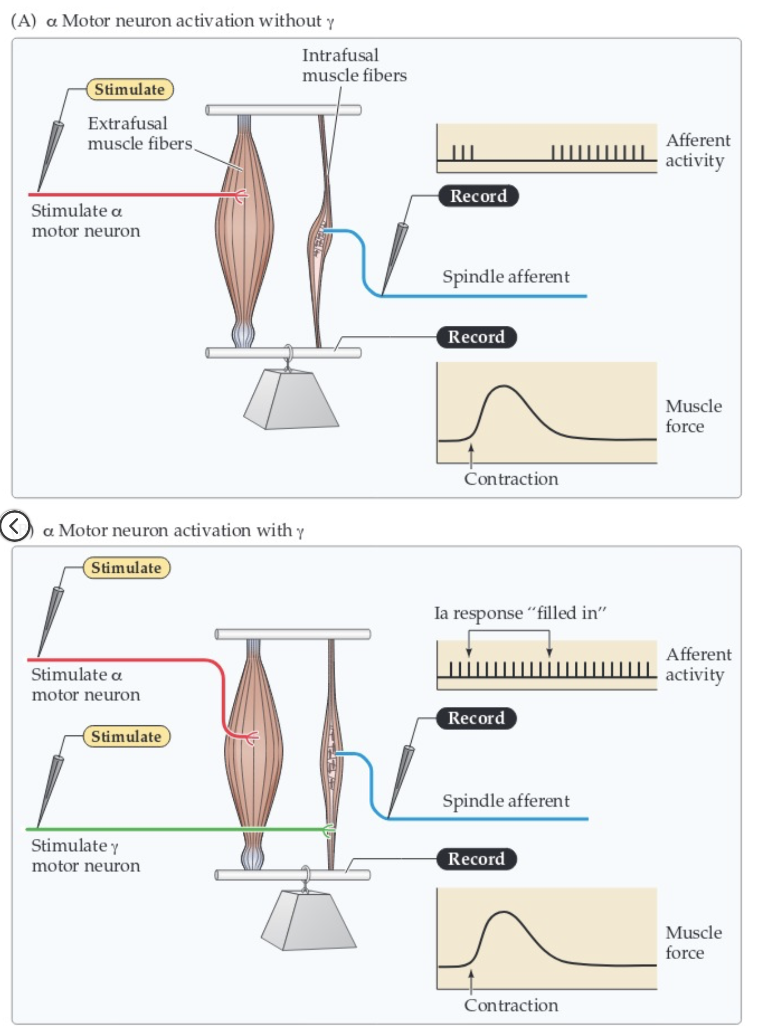

Slide 10
Q: Can we go over the structure of the muscle again (content from the muscle lecture- is the myofibril the smallest unit or is it made up of sarcomeres which are then the smallest unit
Q: Please review stretch reflex circuitry (figure 16.10)
Q: Gamma neurons and modulation of set point of intrafusal fibers
Q: Are soleus muscles extrafusal and tibius anterior muscles intrafusal?

Slide 11
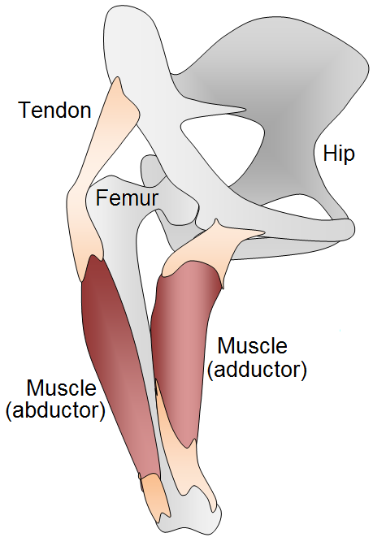
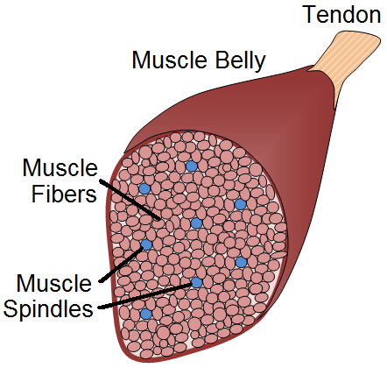
Placement of Spindles
Found in almost all muscles
From 10 to over a 1000 spindles in each muscle
Number of spindles roughly proportional to size of muscle
Do not run the length of the muscle
except for short muscles

Slide 12
Q: I also still get confused with the important content of long-term potentiation and long-term depression.
Q: LTP as it relates to silent synapses

Slide 13
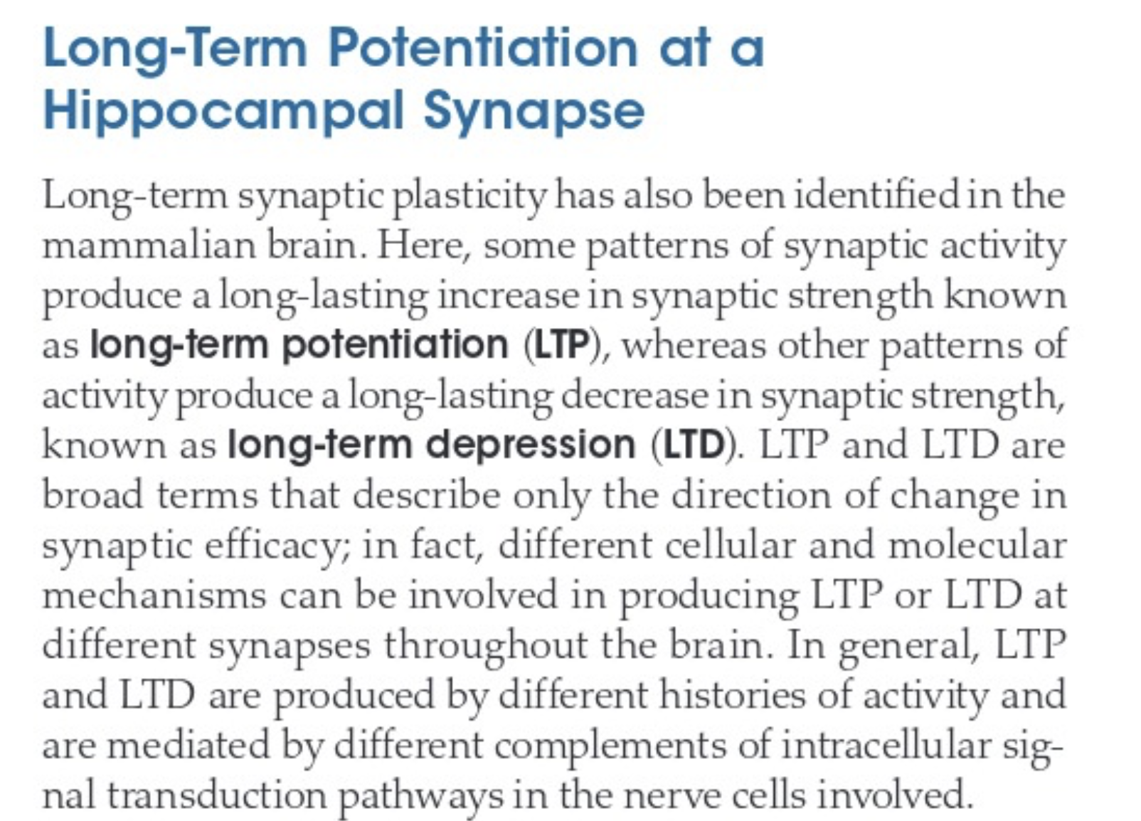

Slide 14
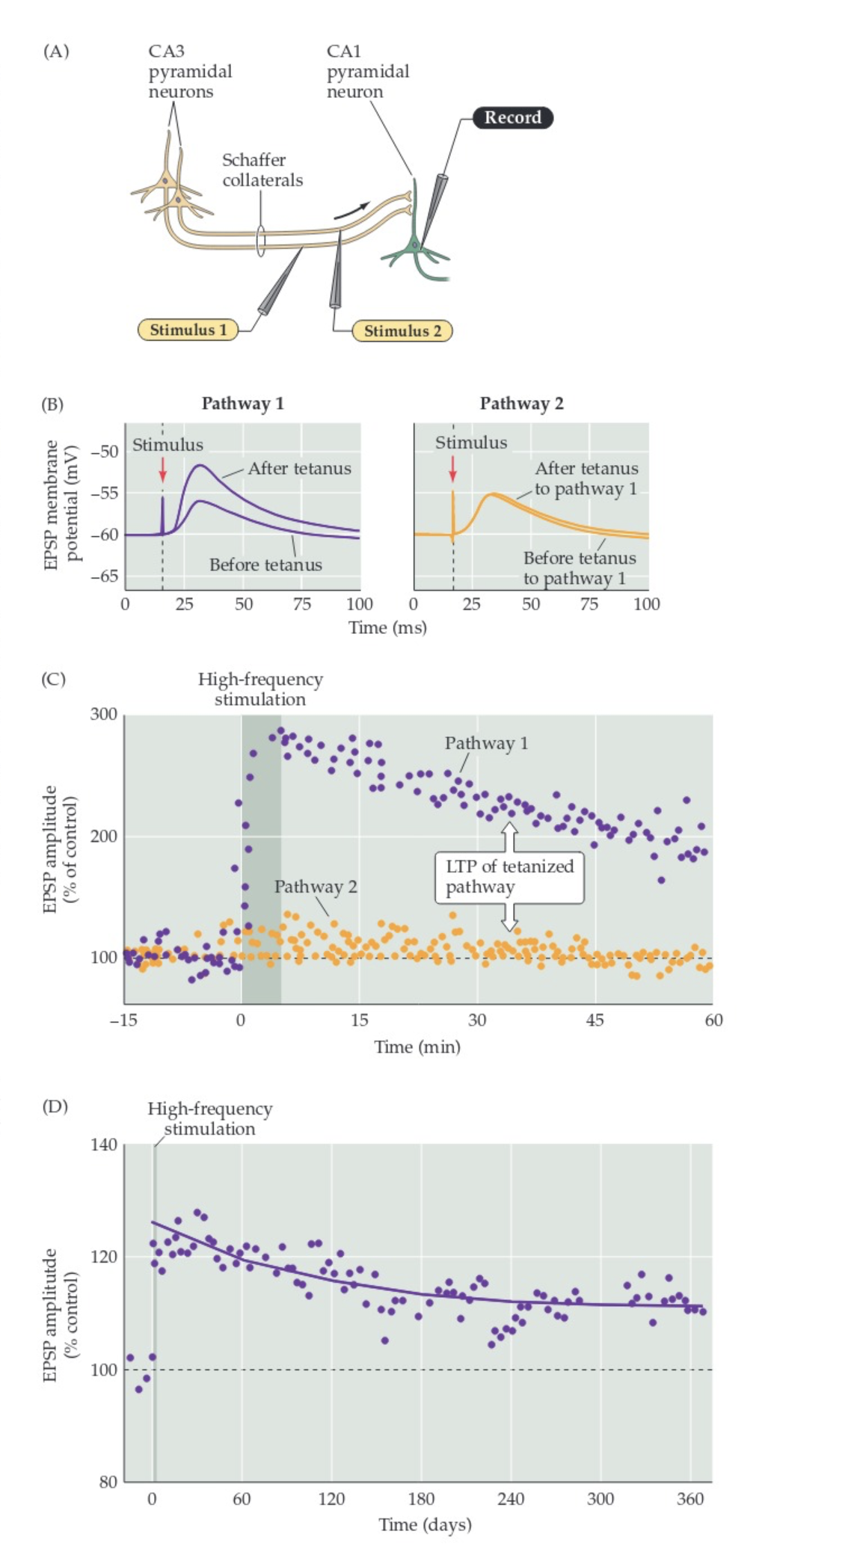
Fig 8.7

Slide 15
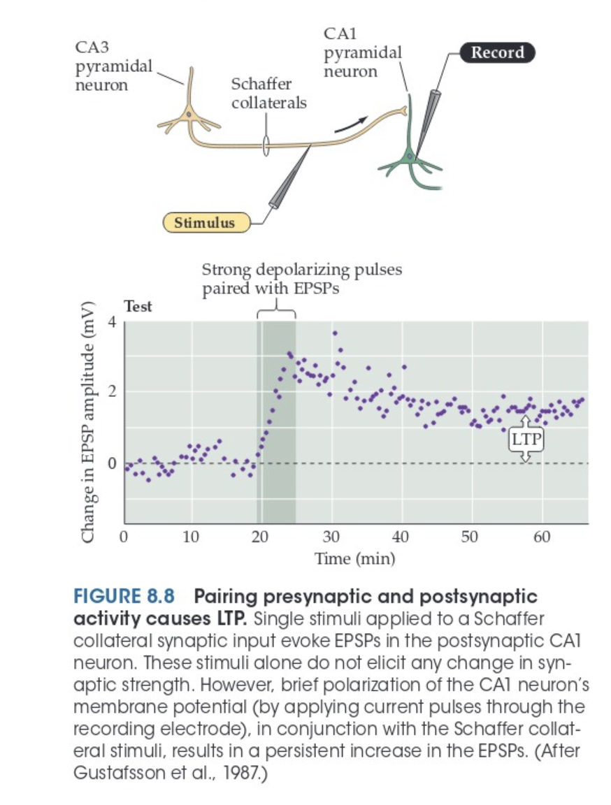

Slide 16
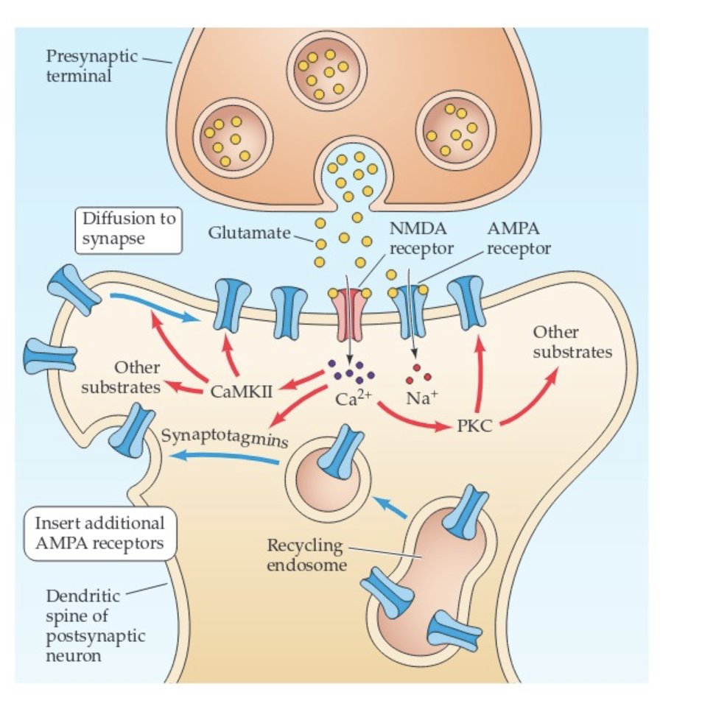
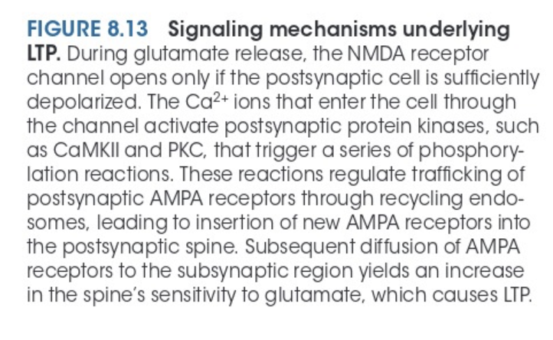

Slide 17
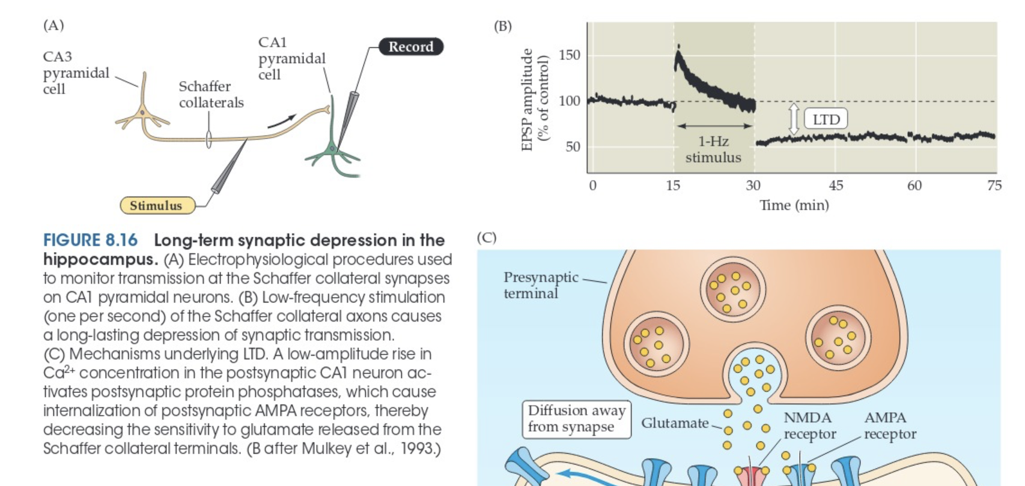
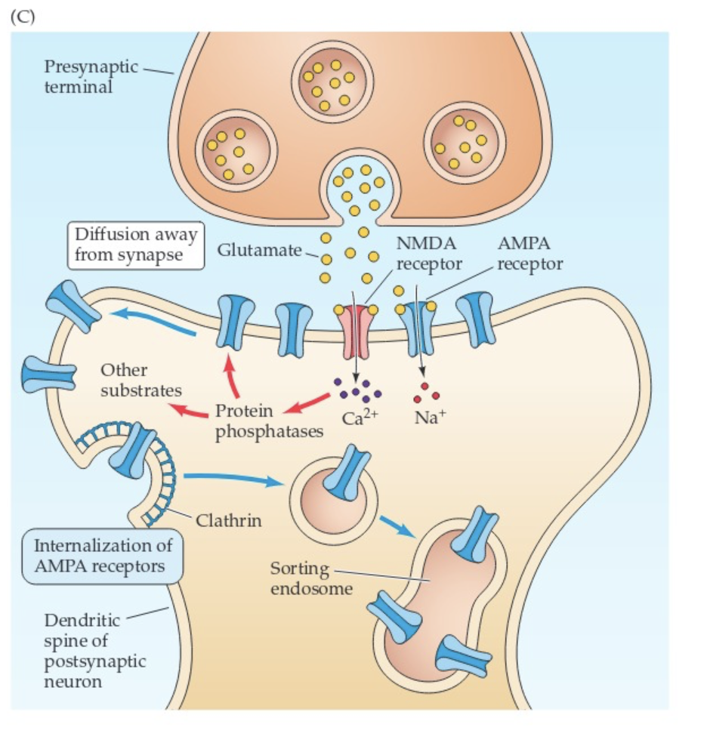

Slide 18
Q: I also still get confused with the important content of long-term potentiation and long-term depression.
Q: LTP as it relates to silent synapses

Slide 19
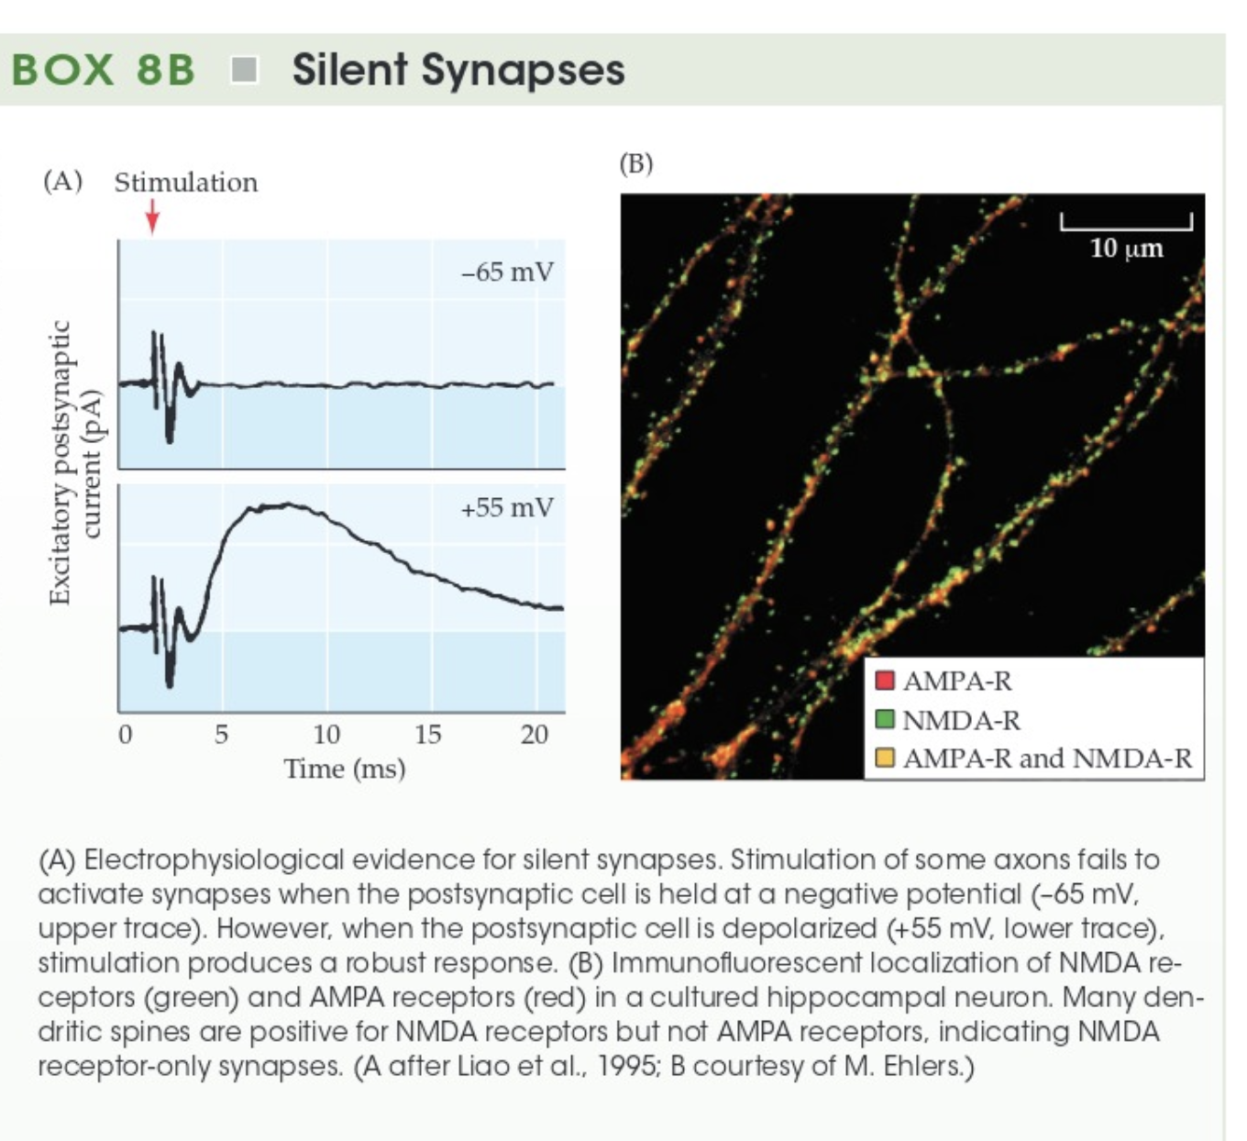

Slide 20
Q: I also still get confused with the important content of long-term potentiation and long-term depression.
Q: LTP as it relates to silent synapses

Slide 21
Q: Review pattern generators
Q: Review MLR and CPG locomotion network
Q: basal ganglia: what is the role of medium spiny neurons?
Q: overarching view of how motion is initiated - do signals originate in motor cortex or do proprioceptive afferents go to cortex first?

Slide 22
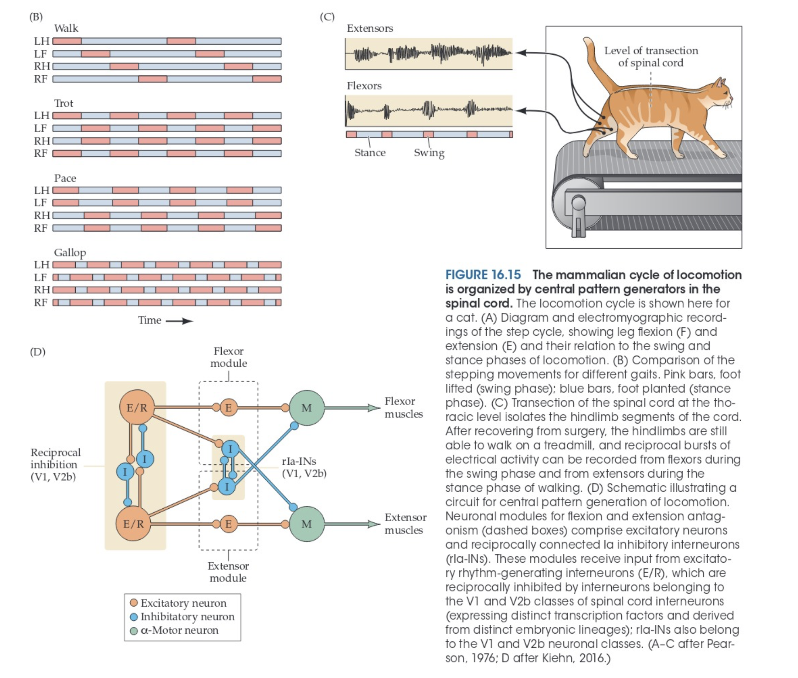

Slide 23
Q: Review pattern generators
Q: Review MLR and CPG locomotion network
Q: basal ganglia: what is the role of medium spiny neurons?
Q: overarching view of how motion is initiated - do signals originate in motor cortex or do proprioceptive afferents go to cortex first?

Slide 24
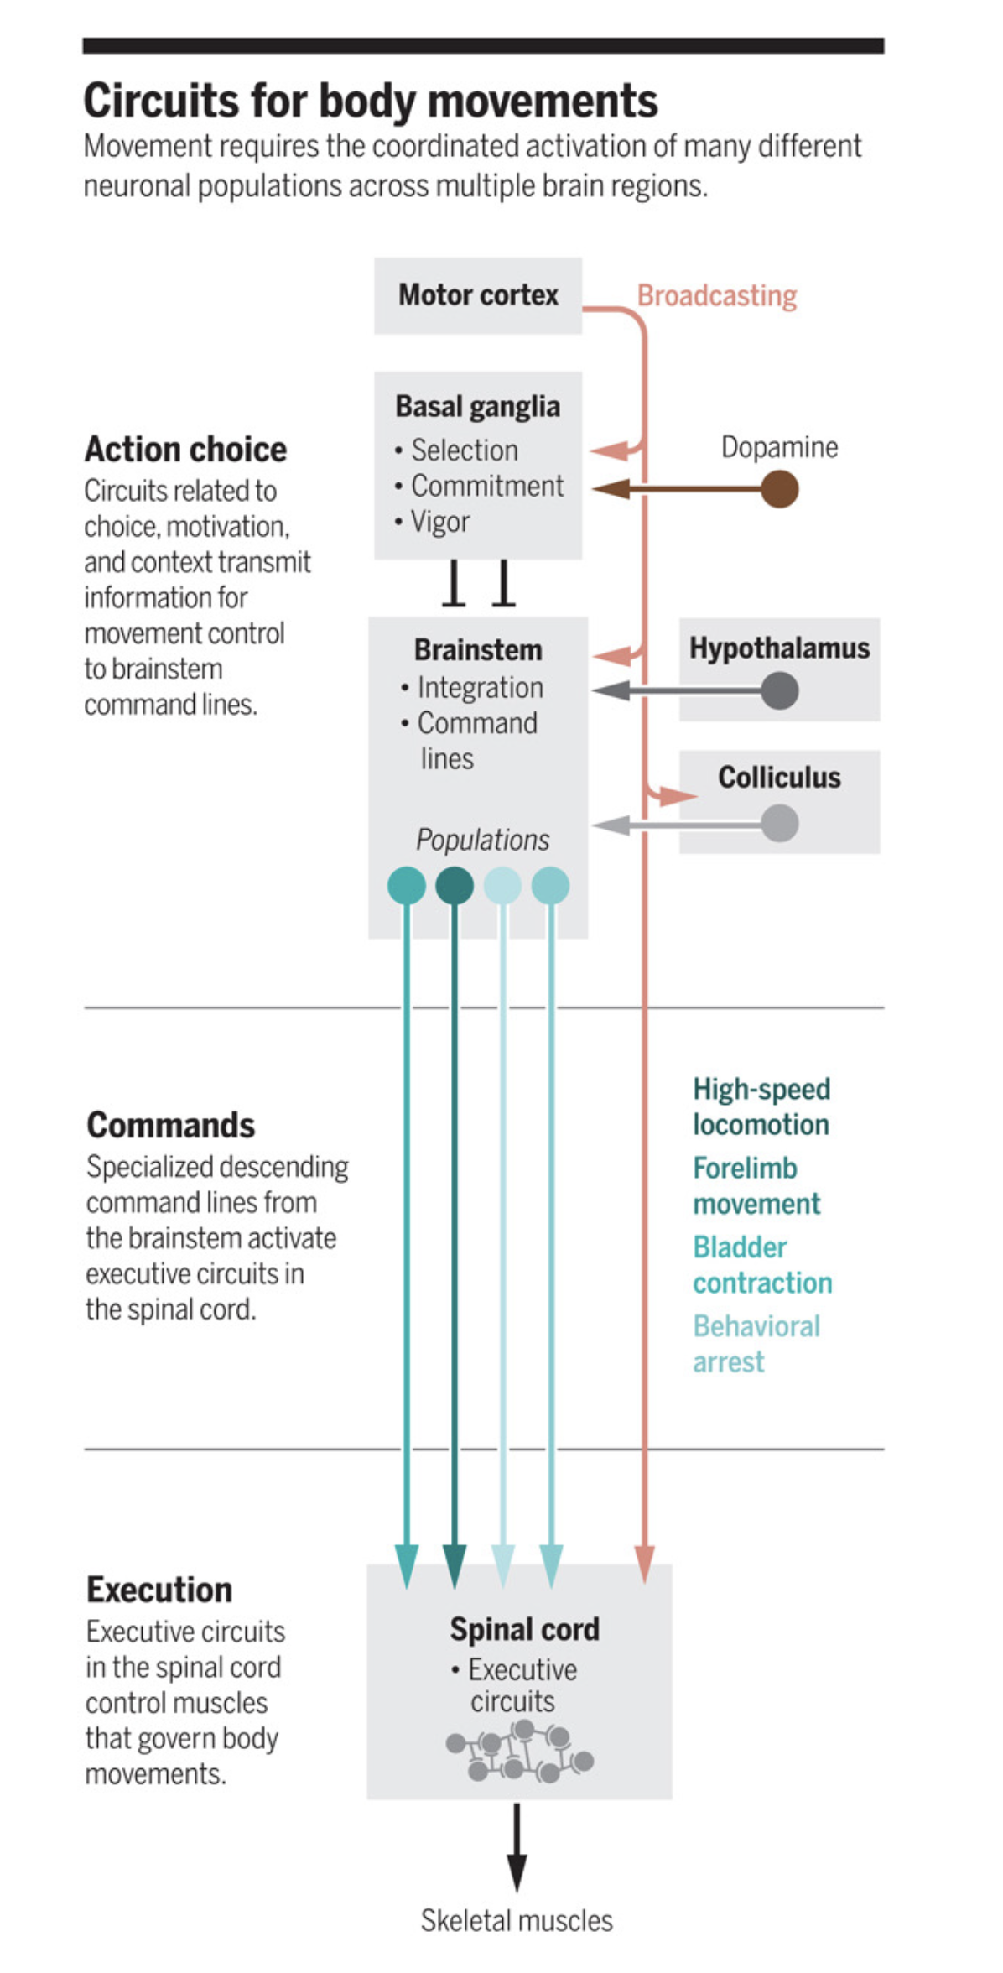

Slide 25
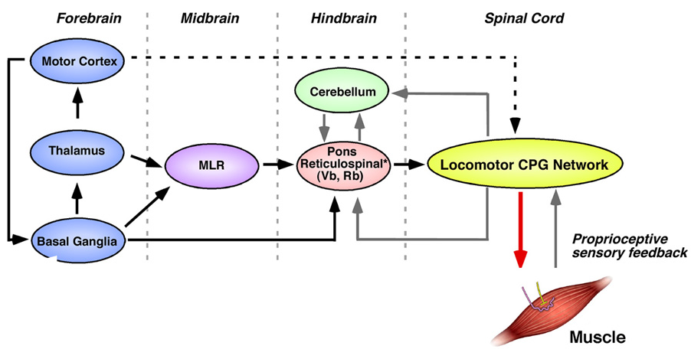
The Interacting Parts
MLR = Mesencephalic locomotor region

Slide 26
Q: Review pattern generators
Q: Review MLR and CPG locomotion network
Q: basal ganglia: what is the role of medium spiny neurons?
Q: overarching view of how motion is initiated - do signals originate in motor cortex or do proprioceptive afferents go to cortex first?

Slide 27
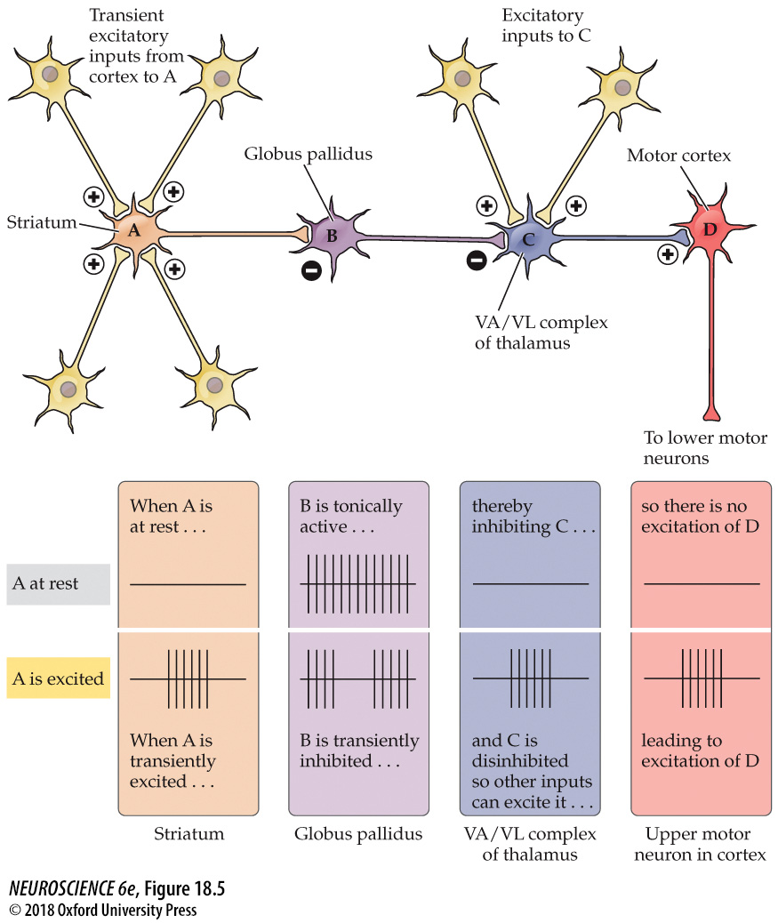
A chain of nerve cells arranged in a disinhibitory circuit

Slide 28
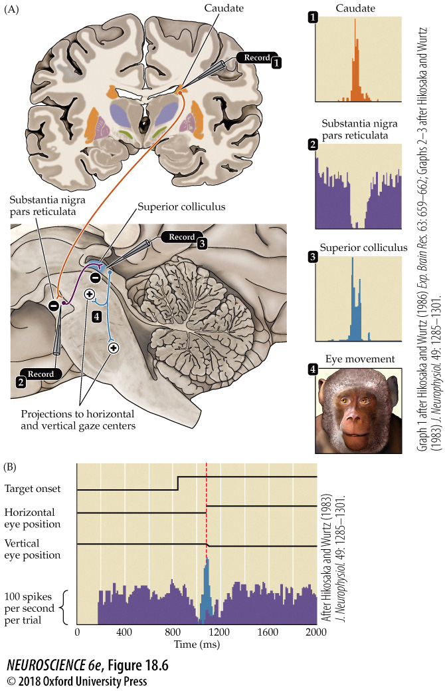
The role of basal ganglia disinhibition in the generation of saccadic eye movements

Slide 29
Q: Review pattern generators
Q: Review MLR and CPG locomotion network
Q: basal ganglia: what is the role of medium spiny neurons?
Q: overarching view of how motion is initiated - do signals originate in motor cortex or do proprioceptive afferents go to cortex first?

Slide 30
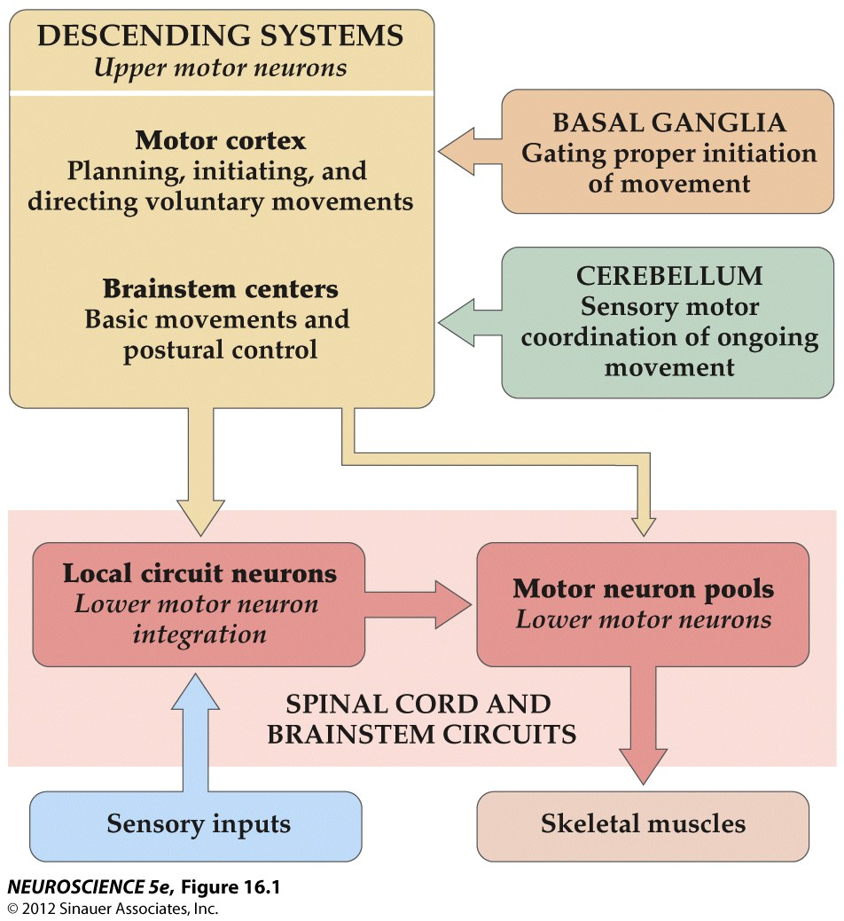
Organization of neural structures involved in the control of movement

Slide 31
Q: Review pattern generators
Q: Review MLR and CPG locomotion network
Q: basal ganglia: what is the role of medium spiny neurons?
Q: overarching view of how motion is initiated - do signals originate in motor cortex or do proprioceptive afferents go to cortex first?

Slide 32
Q: cerebellum pathways
Q: contralateral vs ispilateral
Q: key functions and processes in cerebellum

Slide 33
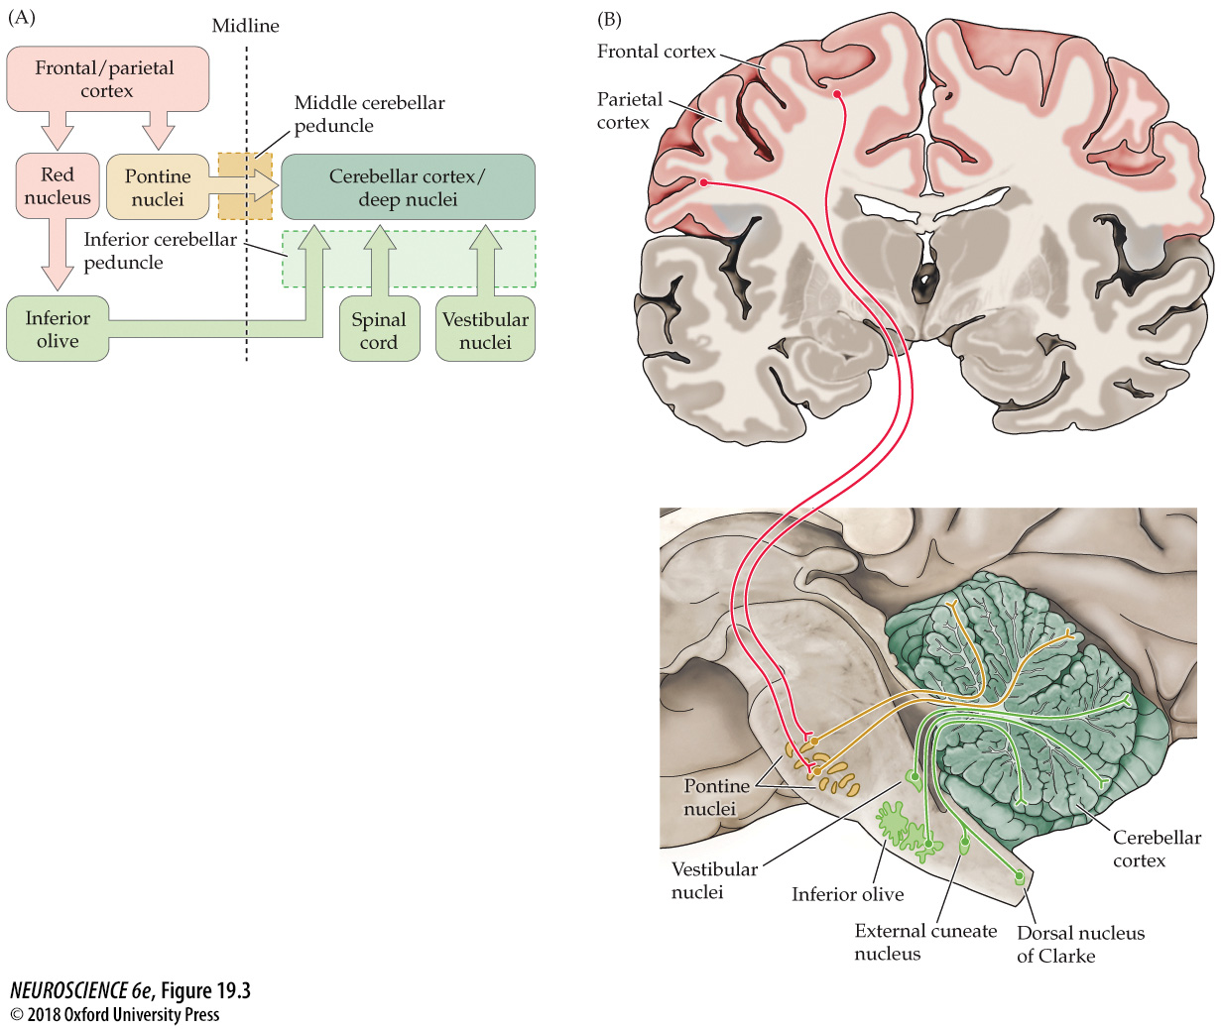
Functional organization of the inputs to the cerebellum

Slide 34
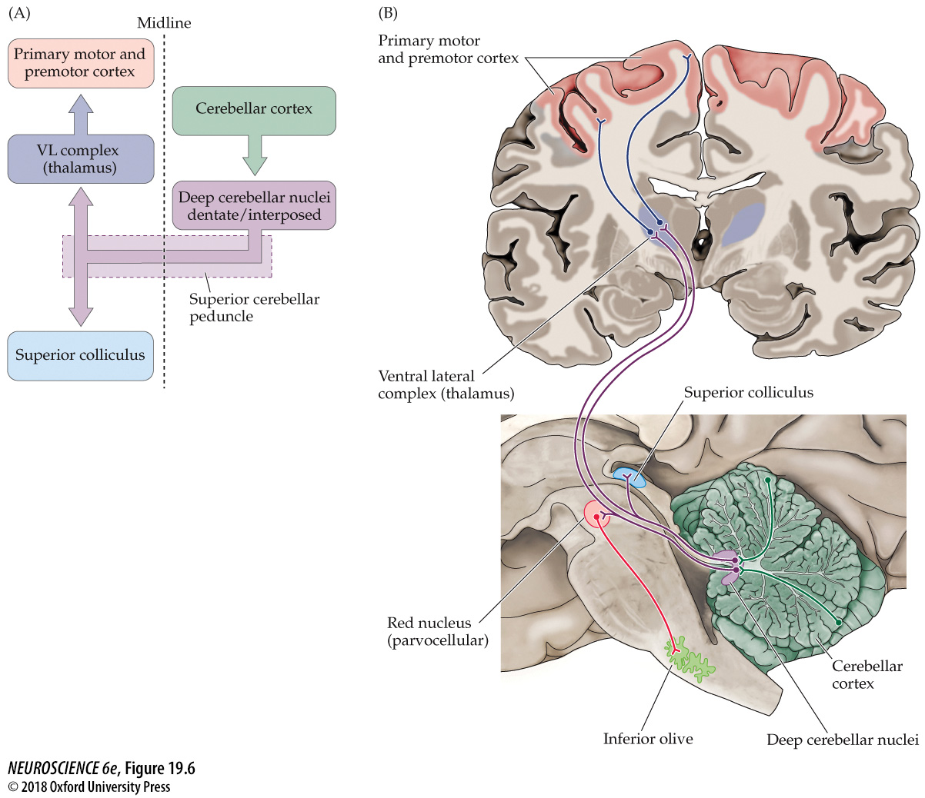
Functional organization of the major outputs from the cerebellum to cortical motor systems

Slide 35
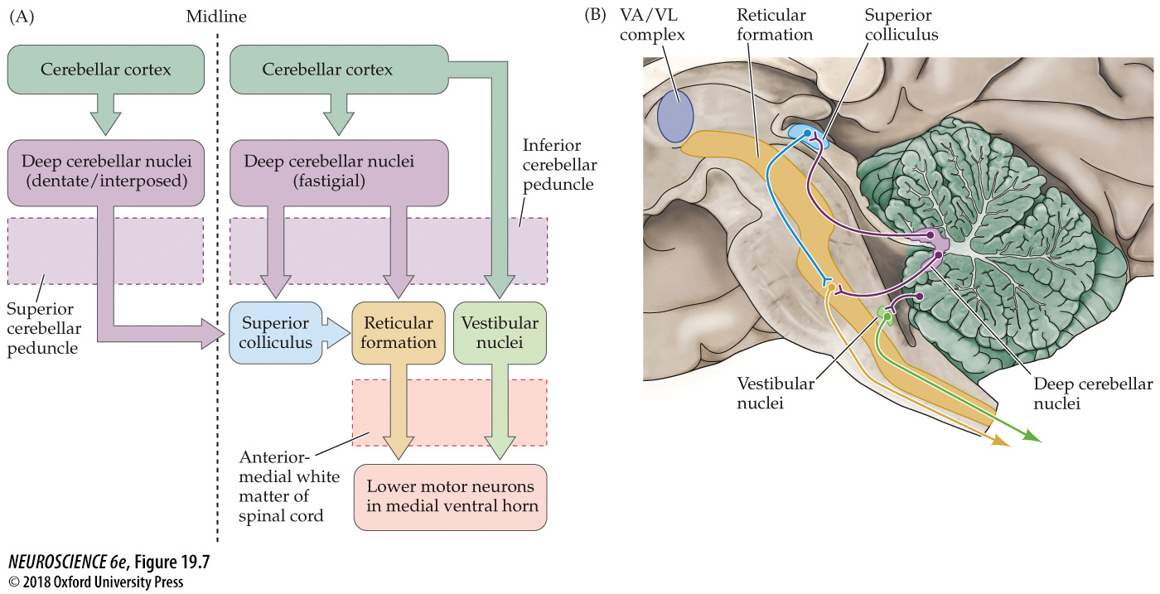
Functional organization of the major outputs from the cerebellum to brainstem motor systems

Slide 36
Q: cerebellum pathways
Q: contralateral vs ispilateral
Q: key functions and processes in cerebellum

Slide 37
Divisions of the Cerebellum
Cerebrocerebellum – regulation of highly skilled movements, especially the planning and execution of complex spatial and temporal sequences of movement (including speech)
Vestibulocerebellum – regulation of movements underlying posture and equilibrium
Spinocerebellum – movements of the distal muscles, such as movements of the limbs in walking, movements of proximal muscles and regulation of eye movements in response to vestibular inputs

Slide 38
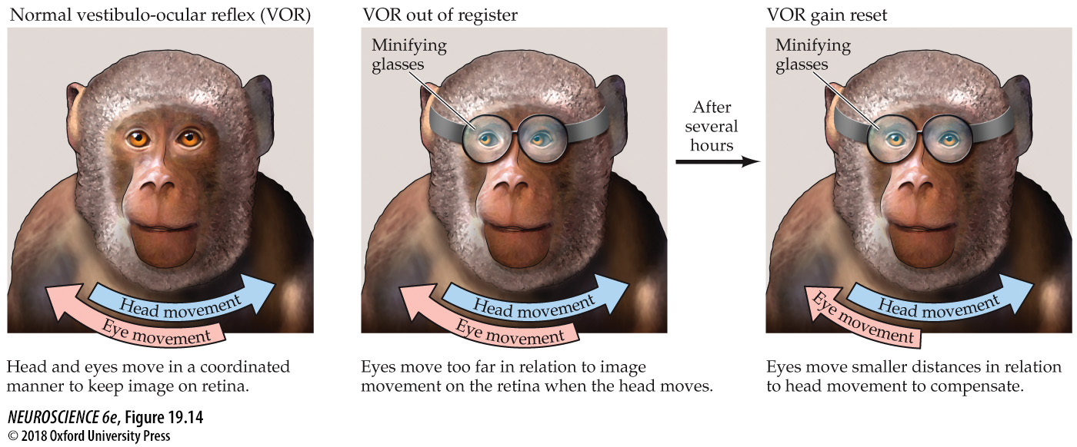
Learned changes in the vestibulo-ocular reflex in monkeys

Slide 39
Q: list of techniques for monitoring neural signals
Q: Spatial & temporal resolution for functional brain imaging techniques

Slide 40
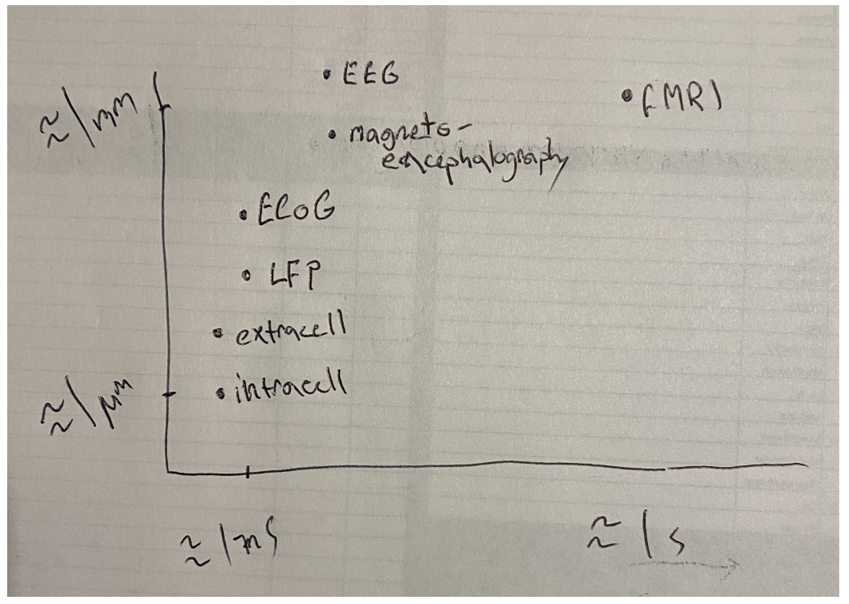

Slide 41
Q: list of techniques for monitoring neural signals
Q: Spatial & temporal resolution for functional brain imaging techniques

